Slide 1
How to flash Artillery Ruby Main Board
The Ruby for the Artillery SideWinder X2, Genius Pro and Hornet
Tutorial made by MrMagounet

Slide 2
Explanation of the method to be used.
Reminder: Any Firmware Flash may present a risk of bricking the Ruby motherboard (in case of handling error or power loss during the process), I cannot be held responsible for any problems during this operation.
this operation should be carried out only on Artillery Ruby 32-bit motherboards, which equips the Hornet, Genius Pro and especially the SideWinder X2, to flash and change Marlin Firmware. We need to either reprogram it via the ISP port which is quite complicated, or to switch the Ruby Motherboard to DFU mode (this is what we will use here).
DFU Mode will restart the Ruby Board in programming mode and releases the serial port for updating the Firmware. But it also activates the Bootloader which allows Firmware to be written to the Motherboard.
Here we will discuss how to pass an Artillery X2 or Genius pro (this will also work the same for the hornet) in DFU mode. Be careful however Artillery seems to have simplified the procedure somewhat for newer models while there will be one more step on the slightly older models of the Genius Pro and X2 (It depends on the firmware version originally mounted on your printer).
Tutorial made by MrMagounet

Slide 3
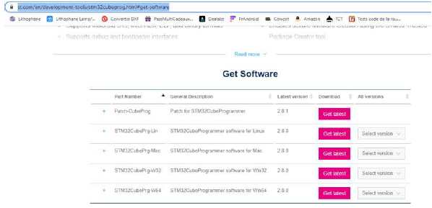
Software needed:
The first useful software is STMicroelectronic which will allow us to flash the printer: https://www.st.com/en/developmenttools/stm32cubeprog.html#get-software .
There are versions for Linux, Mac and Windows.
The Second useful software will be a printer console control software.
Like RepetierHost: https://www.repetier.com/
or PronterFace: https://www.pronterface.com/
For this we will use RepetierHost to put the Ruby in DFU mode.
Tutorial made by MrMagounet

Slide 4
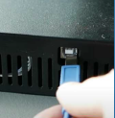
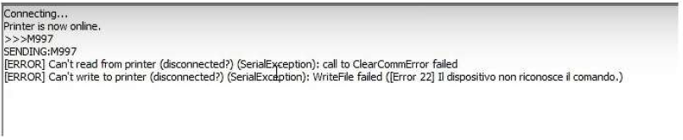

Put the Ruby in DFU mode
Before starting unplug your printer from the 220v mains.
Now connect your printer via USB to your computer, and check that the printer appears in the list of peripherals, Com port & LPT headings (easy way to see which device this is, is plugging and unplugging the printer from the PC, the one that appears and disappears is the printer).
Launch RepetierHost and open communication with your printer. You must select the Com port, that corresponds to the one your printer is connected to, and choose the correct communication baud (speed), this will be either 115200 or 250000. (if your printer is original it’s normally 115200)
Now in the command console type the command M997 then validated with the enter key.
The printer restarts in DFU mode (the 2 error lines in RepetierHost are linked to the loss of connection, this is normal), you can close RepetierHost.
Now in the Windows device manager, the printer no longer occupies the previous Com port but appears in the USB devices as STM32 BOOTLOADER.
Tutorial made by MrMagounet

Slide 5
Attention variation!
Be careful if your printer did not restart in DFU mode with the M997 command, and it does not appear in USB devices as STM32 BOOTLOADER, if this is the case you will have to open the printer case to perform a manipulation on the ISP port of the Ruby Motherboard.
See the alternative method part, at the end of the document.
Tutorial made by MrMagounet

Slide 6
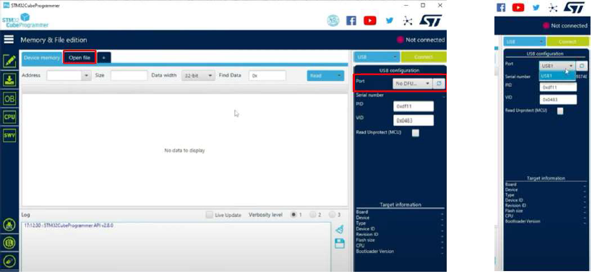
Flash Custom Firmware to Ruby
Reminder: Perform the manipulations with the printer switched off at 220v (best practise to be completely unplugged), it will be powered only by the USB port.
Now launch the STM32CubeProgrammer software and in the Port drop down the usb port of your printer should appear otherwise click on the refresh button.
Then go to Open File and find the .bin file of the firmware to install and select open (it will load into the STM32 software).
Tutorial made by MrMagounet

Slide 7
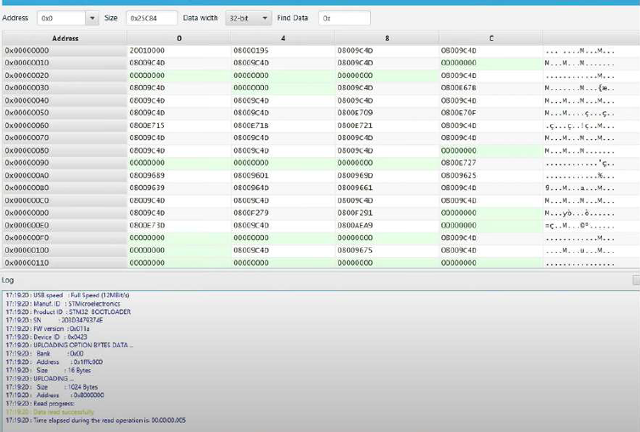
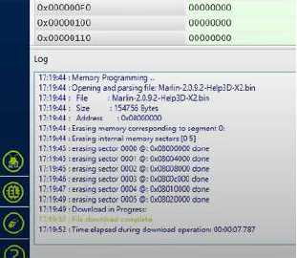
Now Click on the connect button to connect to the printer, then click on Download to Flash the Printer with your previously selected Firmware.
You can install a new TFT firmware if need,
Once flashed unplug the USB cable from the PC, your printer will now be flashed with your new Firmware.
Turn your printer back on, you’ll be prompted to Eeprom reset and level the bed.
Tutorial made by MrMagounet

Slide 8
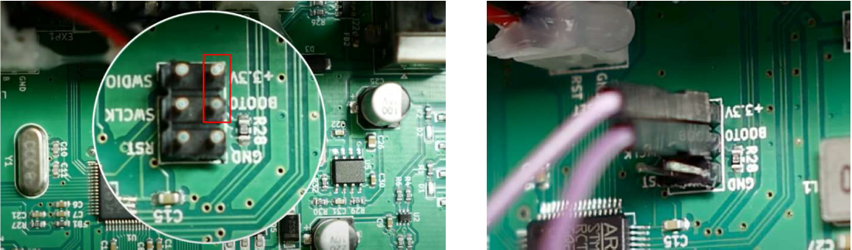
Alternative method:
- Disconnected the 220V cable and the USB cable. the printer must be turned off.
- Open the case of your printer. Watch out for the fan on the bottom plate.
- You will need a Dupont Female/Female cable, you will have to wire it (make a strap) on pin 3.3v and Boot of the ISP port of the Ruby Motherboard.
Tutorial made by MrMagounet

Slide 9
Now you can connect the printer's USB cable and resume the normal procedure with the STM32CubeProgrammer software, view page 6.
Once the Firmware Flash has been completed, remove the USB cable from the printer, then the Dupont cable from the 3.3v and BOOT pins of the ISP port, and close your printer.
Your printer is now updated. (Depending on Custom Firmware used it will probably be necessary to redo this process in the future)
Tutorial made by MrMagounet

